Slide 1
Restaurant Finder & Diet Planner
Katta Nikitha-22
Dandamudi Naga Mounika-9
Goli Venkata Govardhan-14

Slide 2
Functionalities
Sign up
Point out our location
Search near by restaurants
Directions to selected restaurant
BMI Chart
Calorie Counter
Diet Chart
Google plus plugging
Location API
Google Maps API
Food API
Calendar plugging

Slide 3
Specifications
Platform : Android Studio
Languages: java
IDE: Android Studio
Libraries:
Database: SQLite
UML Diagram: Microsoft Visio
Project Management:

Slide 4
Architecture
Login
Application
Location API
Google maps API
SQLite
Food API

Slide 5
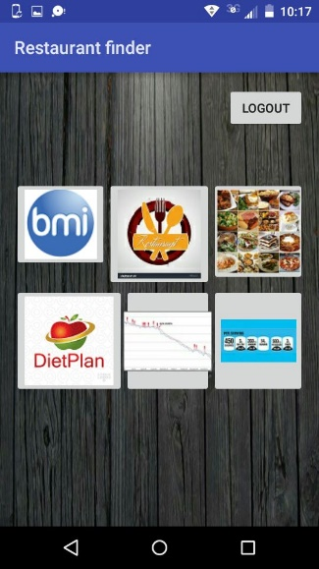
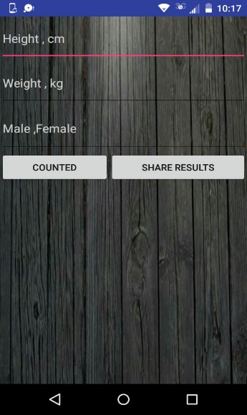
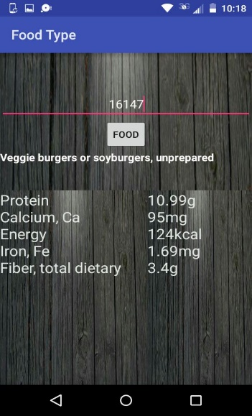
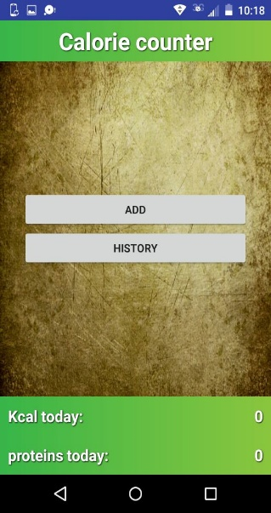
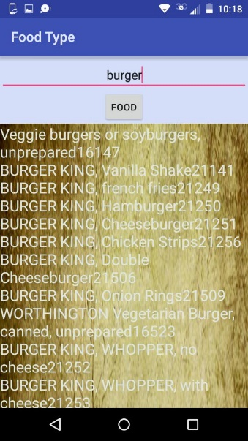
Screen Shots

Slide 6
THANK YOU

